Slide 1
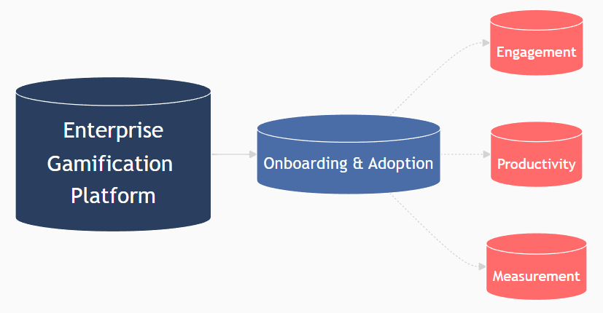
Enterprise Gamification Platform for Onboarding & Adoption
Drive Engagement, Accelerate Productivity, and Measure Success

Slide 2
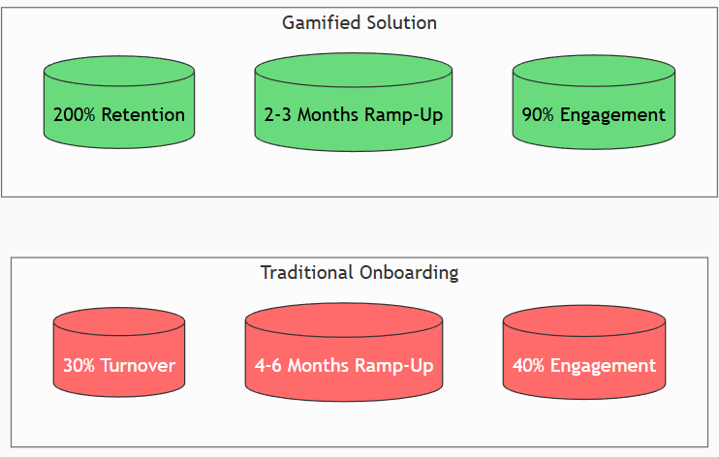
Gamification is a Game-Changer
Problem: Traditional onboarding is costly, slow, and disengaging (~30% turnover in first 90 days).
Solution: Gamification boosts engagement by 60%+ and cuts time-to-proficiency by 50%.
ROI: Enterprises see 200%+ higher retention and measurable productivity gains. Visual: ROI stats in bold, side-by-side comparison (Old vs. New).

Slide 3
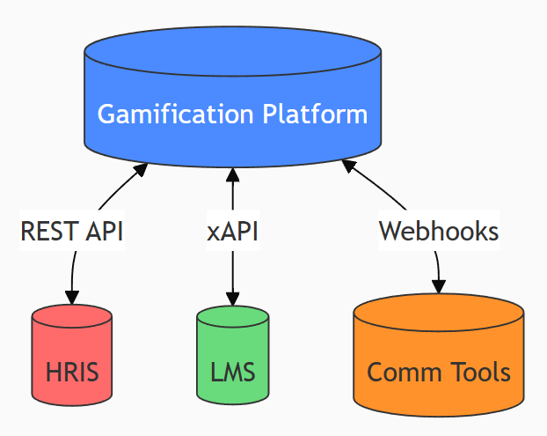
Gamification = Game Mechanics + Behavioral Science
Mechanics: Points (XP), Badges, Leaderboards, Quests, Levels, Avatars.
Dynamics: Progression, Competition, Collaboration, Rewards.
AI/ML: Adaptive learning paths, predictive analytics for engagement.
API Integrations: Works with LMS (Workday, Cornerstone), HRIS (SAP SuccessFactors), MS Teams, Slack. Visual: Ecosystem diagram (Platform

Slide 4
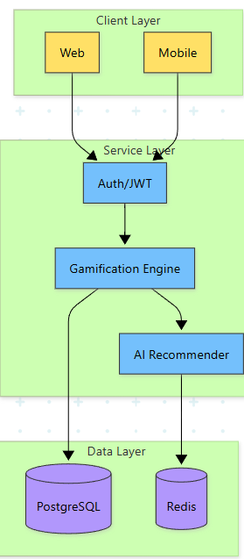
Architecture of a Gamified Onboarding Platform
User Journey Mapping – Personalized onboarding quests.
Real-Time Analytics – SCORM/xAPI compliance for tracking.
Microlearning Modules – Bite-sized, mobile-friendly content.
Social Proof – Peer recognition via NFTs (optional). Visual: System architecture

Slide 5
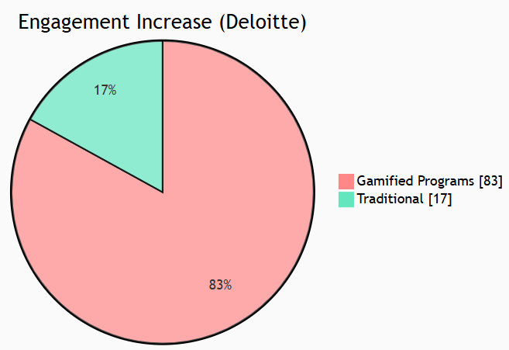
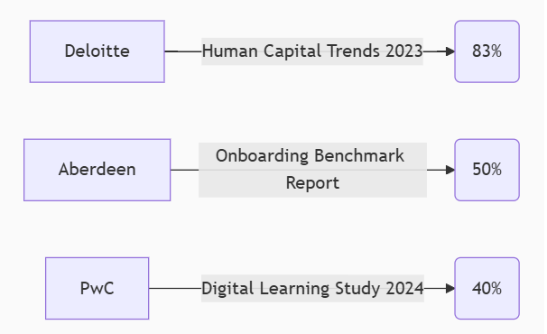
The Business Case for Gamification
📌 Deloitte: Gamified programs improve retention by 83%. 📌 Aberdeen Group: 50% faster onboarding vs. traditional methods. 📌 PwC: Gamification increases productivity by 40%.

Slide 6
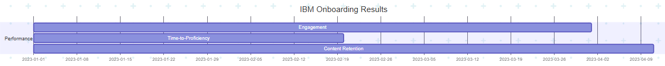
Ideal Scenarios for Gamification
M&A Integration: Align cultures post-merger (e.g., Salesforce onboarding).
Digital Transformation: Drive adoption of new tools (e.g., SAP rollout).
Compliance Training: Turn dry content into interactive challenges.

Slide 7
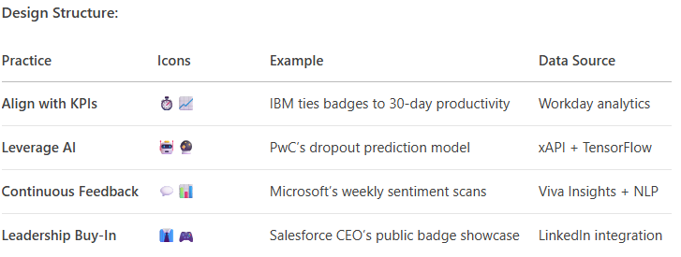
How Top Companies Succeed with Gamification
Align with KPIs – Tie rewards to time-to-productivity, completion rates.
Leverage AI – Use predictive analytics to flag at-risk learners.
Continuous Feedback – Pulse surveys + sentiment analysis.
Leadership Buy-In – Executives should publicly endorse & participate.

Slide 8
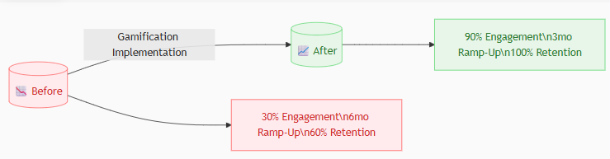
IBM’s Gamified Onboarding (New Hire Orientation)
90% engagement rate (vs. 30% previously).
2x faster ramp-up for sales teams.
Badges = 40% higher content retention. Visual: Before/After dashboard mockup.

Slide 9
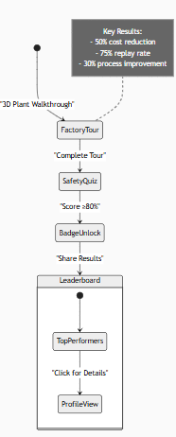
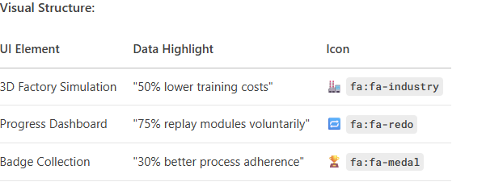
Siemens’ "Plantville" (Simulation Gamification)
50% reduction in training costs.
75% of employees voluntarily replayed modules.
30% improvement in process adherence. Visual: Screenshot of Plantville UI.

Slide 10
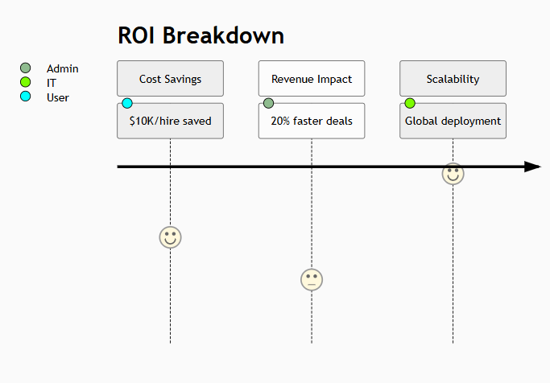
Tangible ROI for Leadership
💰 Cost Savings: Cut onboarding time = $10K+/hire saved. 📈 Revenue Impact: Sales teams close deals 20% faster. 🔄 Scalability: Deploy globally in weeks, not months. Visual: Financial impact infographic.

Slide 11
Mitigating Risks, Maximizing Rewards
Pros | Cons | Mitigation
+60% engagement | Over-Gamification | Use balanced mechanics
50% faster learning | Upfront costs | Start with MVP pilot
Real-time analytics | Change resistance | Champions program

Slide 12

Next Steps to Launch Gamification
Pilot Program – Test with 100 new hires (3-month sprint).
Custom Demo – See platform tailored to your workflows.
ROI Forecast – We’ll model your expected savings

Slide 13
